Slide 1
Housing Price Analysis
Jason Pham
Harinaathgobi Chelva Sriman
Praphul Gowda
Myroslav Tkachenko
Yilin Bao

Slide 2
Table of Contents
Motivation and Objective
Dataset
Analysis
Recommendation: Renting vs Buying a home
Predicting Home Prices

Slide 3
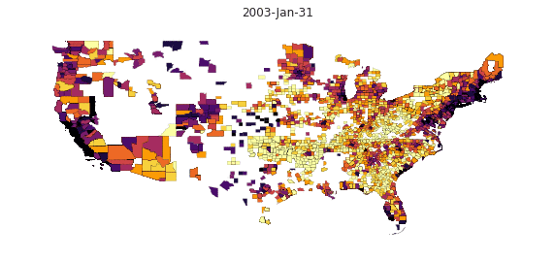
Motivation and Objective
Analyze housing price data
Verify that current sentiment about housing being unaffordable is correct
Isolate factors that affect housing affordability
Decide if renting is better than buying a home
Predicting Home prices given a set of ideal factors

Slide 4
Dataset and Methodology
Zillow Housing Dataset for Prices/Rent
FRED API for Inventory, Median Income, Migration
FIPS dataset for plotting maps
US Census Data
Show a comparison between Home Price and Some Factor
Isolate Factors that would increase accuracy when predicting

Slide 5
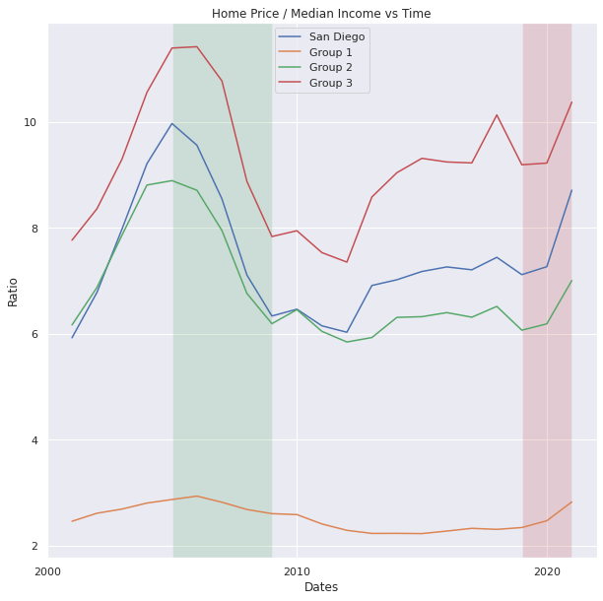
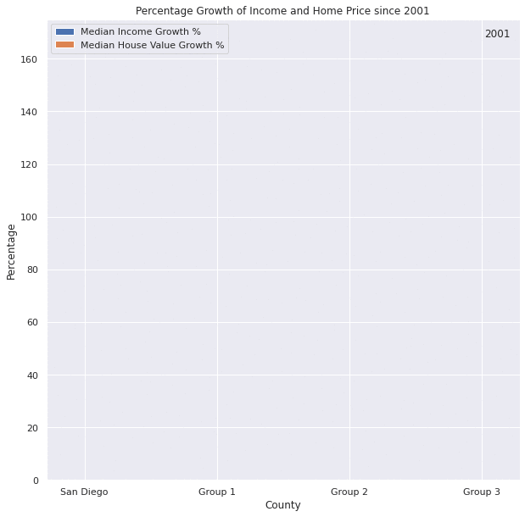
Affordability
Group 1: Youngstown, St. Louis
Group 2: Ventura, Boston, New York
Group 3: Los Angeles, San Francisco, San Jose

Slide 6
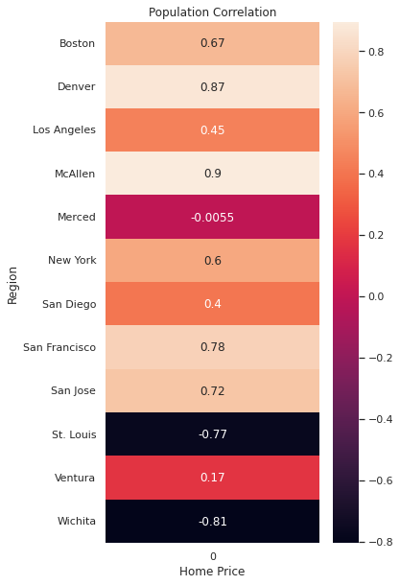
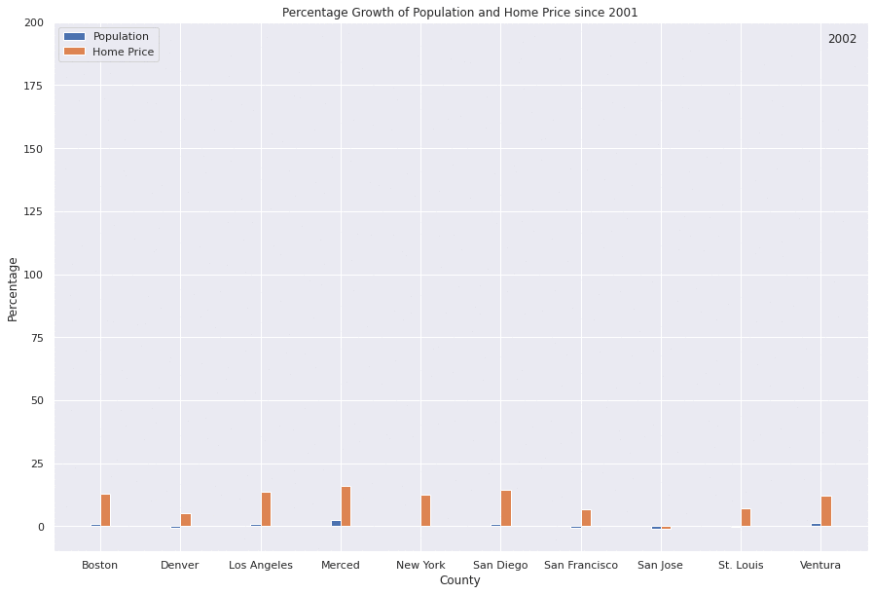
Migration

Slide 7
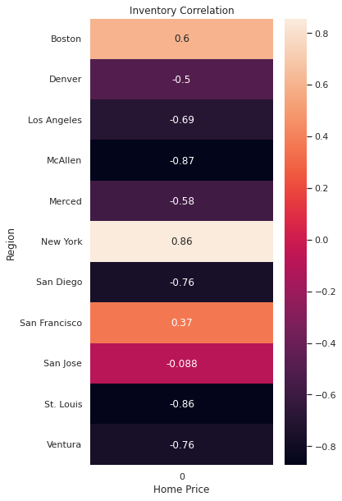
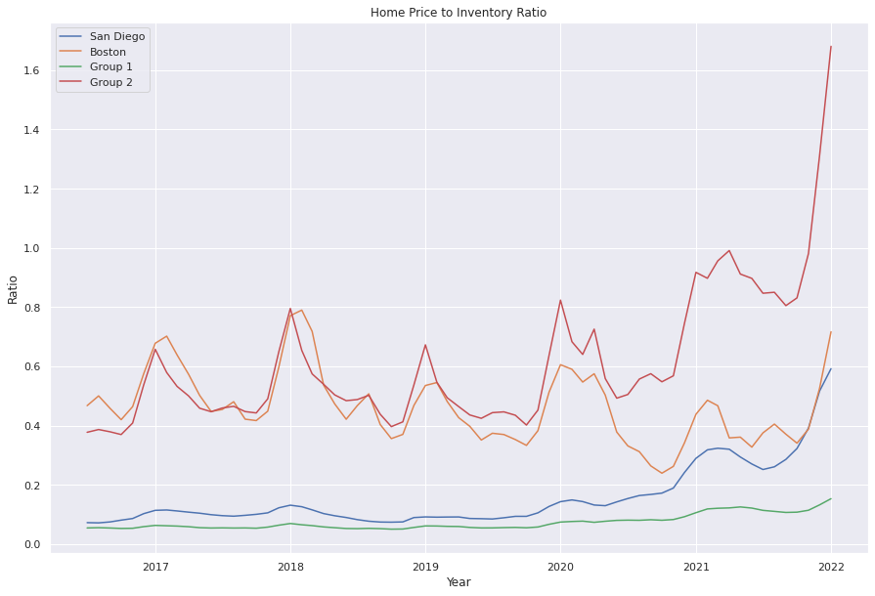
Inventory
Group 1: New York, McAllen, Los Angeles, St. Louis
Group 2: San Jose, Denver, San Francisco, Merced, Ventura

Slide 8
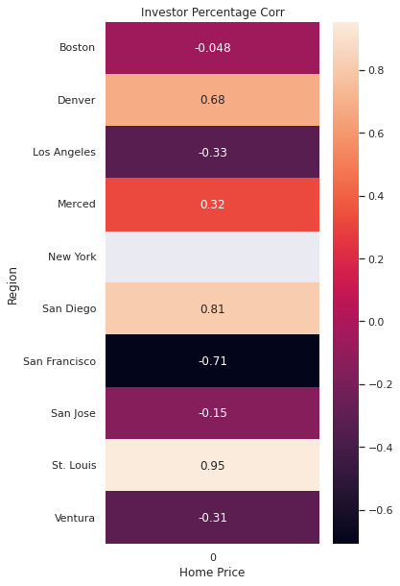
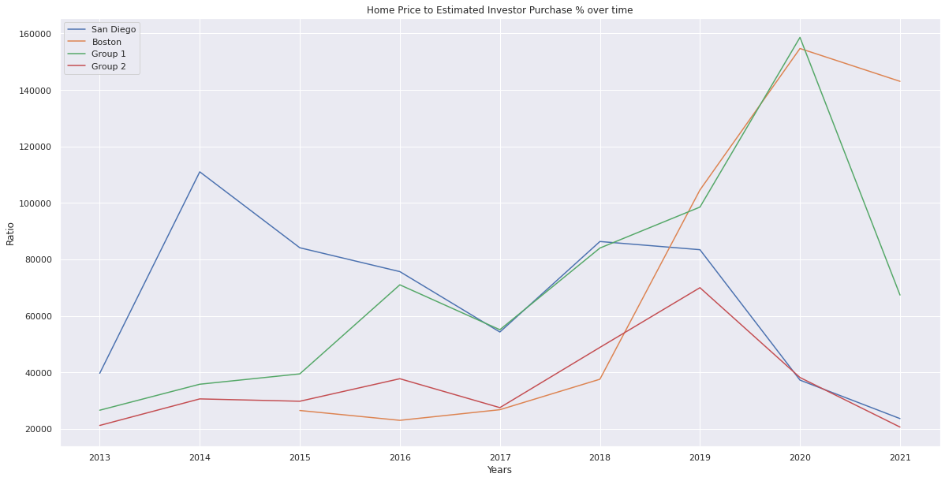
Investor Purchases
Group 1: Ventura, Los Angeles, San Francisco
Group 2: St. Louis, Denver, San Jose, Merced

Slide 9
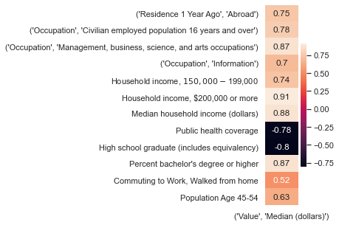
Correlation
Notes:
Highest positive and negative correlations out of all factors as well as highest correlation from specific groups. Commuting to work by walking had the highest correlation out of all commuting methods, likely because people who are able to commute to work live in large cities, which tend to be more expensive. Population between ages 45-54 is the highest correlated age group with price.

Slide 10
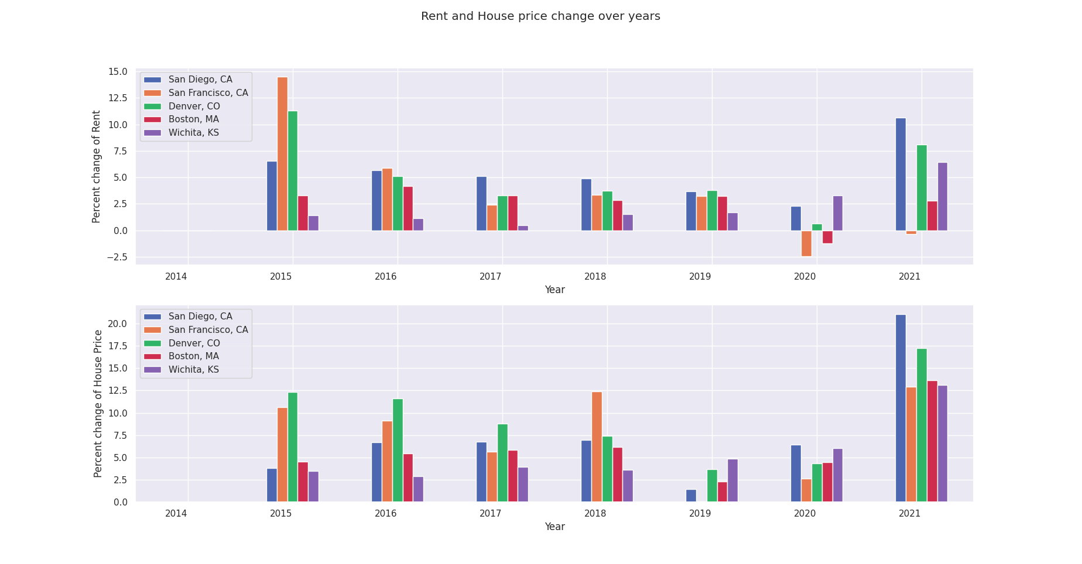
Rent vs House price change comparison
Note: Comparison made with 3BR housing and rent values
Notes:
Here we are looking at the percentage change in rent vs house price over years for 5 counties. The top part represents percentage mean rent change from previous year for each county and the bottom part represents the percentage mean house value change from previous year. Covid has caused more increase in house value as well as rent. It can be observed that San Diego has the highest percentage rent increase and highest percentage increase in house value post covid.

Slide 11
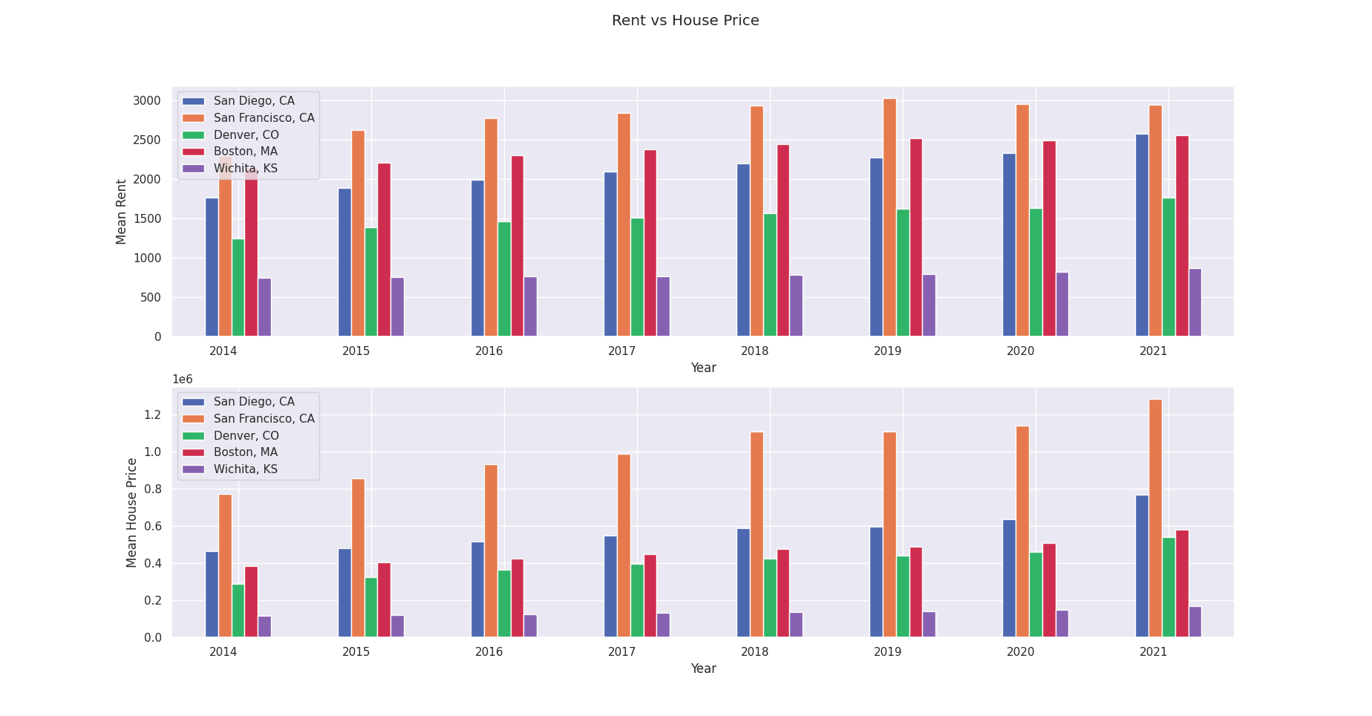
Rest vs House price comparison
Optional Slide

Slide 12
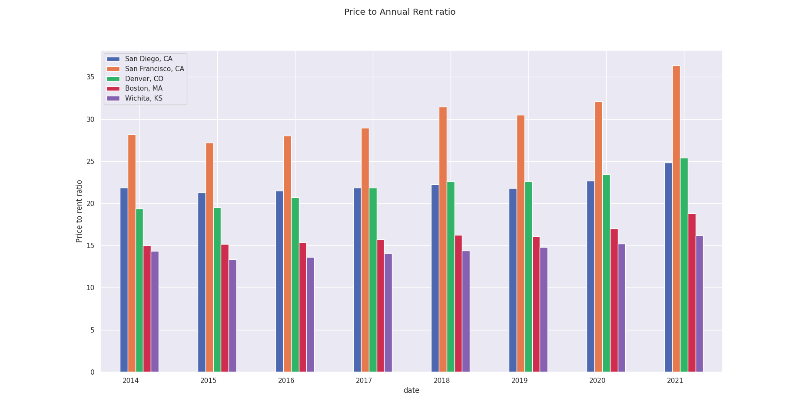
Price to Annual Rent Ratio comparison
https://www.investopedia.com/terms/p/price-to-rent-ratio.asp
If Price to Annual Rent ratio is less than 15, it would be a good investment to buy a house rather than rent
Notes:
Some interesting insights from this graph includes
It is better to rent house in SF, San Diego and Denver
Till 2017-2018 it was better to buy a house in Boston
It is better to buy a house in Wichita, Kansas even now (Post covid) making it an affordable option.

Slide 13
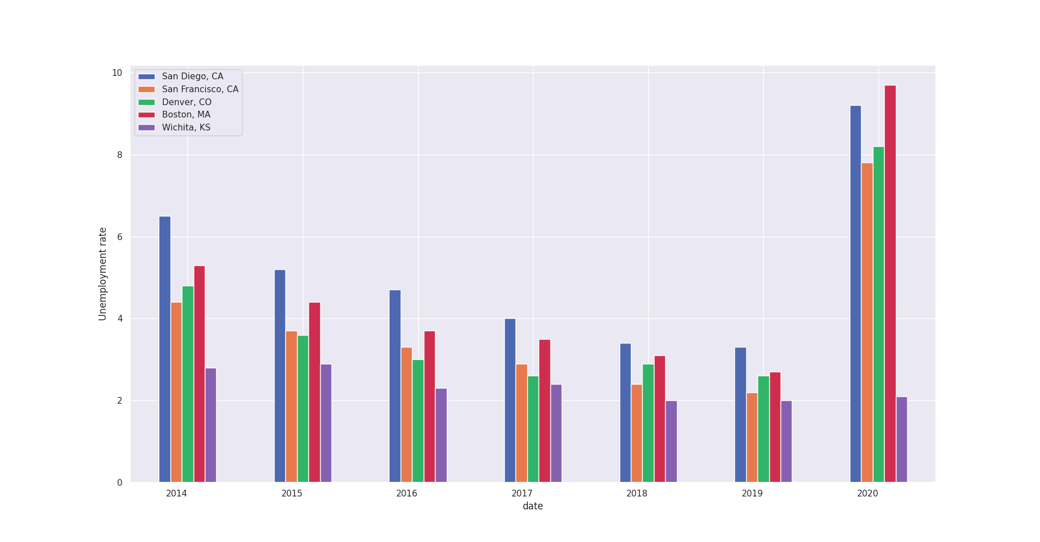
Unemployment rate comparison
Fun fact: https://www.kwch.com/2021/01/27/kansas-ranks-in-top-5-of-most-boring-states/
Unemployment rates give insights on the economic condition of the counties. It is always preferred to move to counties with low unemployment rates and affordable rent/ housing prices.
Notes:
The Unemployment rate of San Diego is very high and so is the rent and house value making it the most unaffordable county of the bunch.
Interestingly Wichita has affordable housing price, rent as well as very low unemployment rate. One reason is Wichita, Kansas has very less population compared to other county/states in the graph.

Slide 14
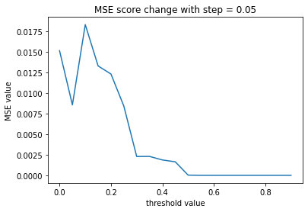
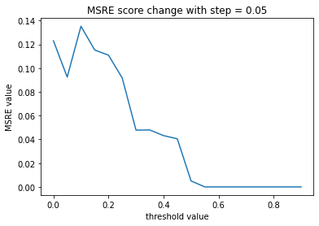
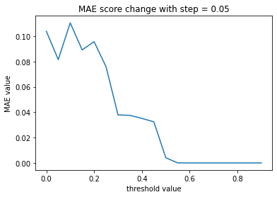
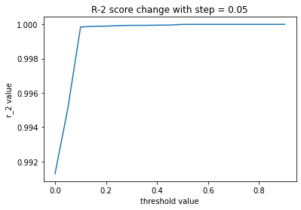
Threshold for selecting features
Step:
find 96 factors with Pairwise Correlation(PC) with housing price with range of [-1,1]
Set the thresholds at 0.5 intervals and then for every threshold get the subset of factor with abs(PC) > threshold.
calculate the MAE, MSE, R_2score to find the optimal threshold of Linear Regression.
Conclusion:
The factors with abs(PC) > 0.6 are more decisive than other
Ignoring other factor to build the model can exclude most of the noise

Slide 15
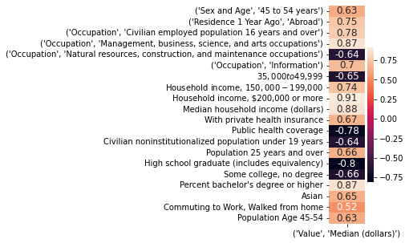
Features

Slide 16
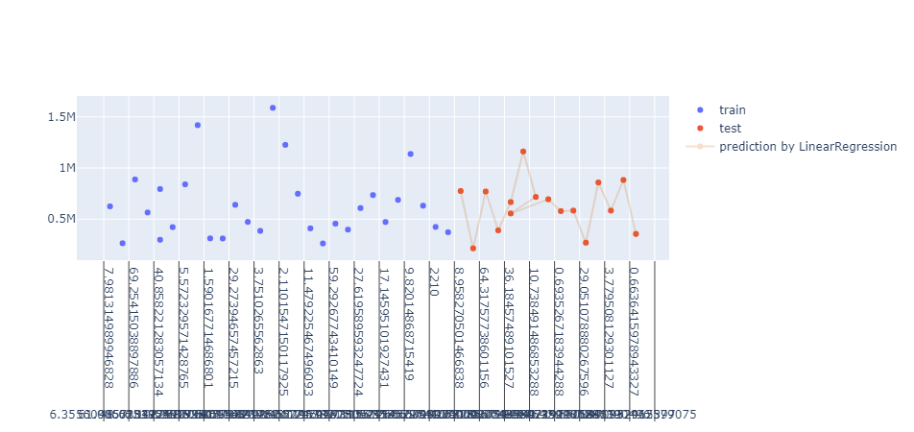
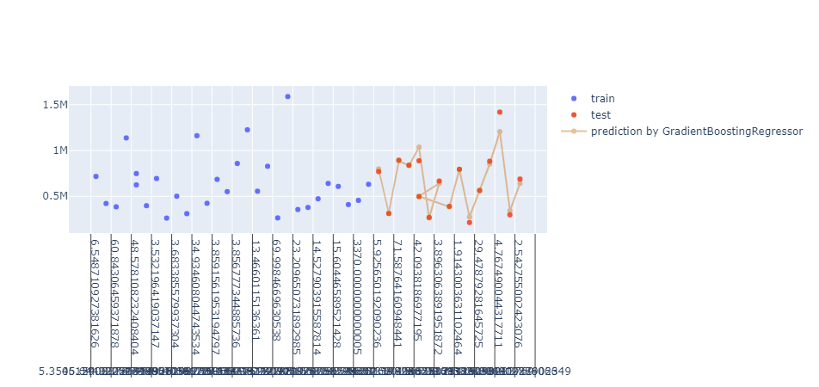
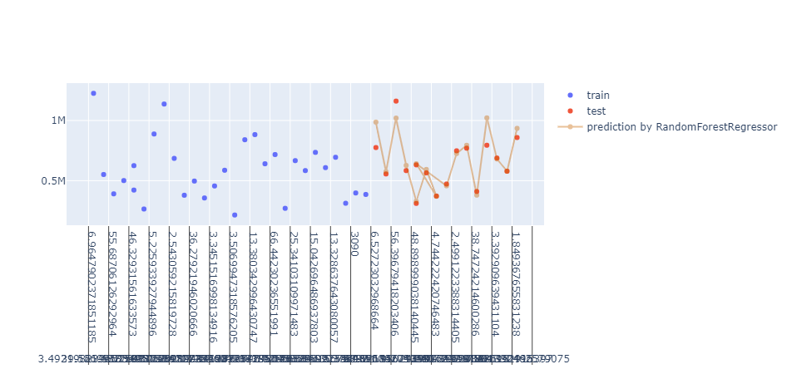
Train result
GradientBoostingRegressor
RandomForestRegression
Linear Regression

Slide 17
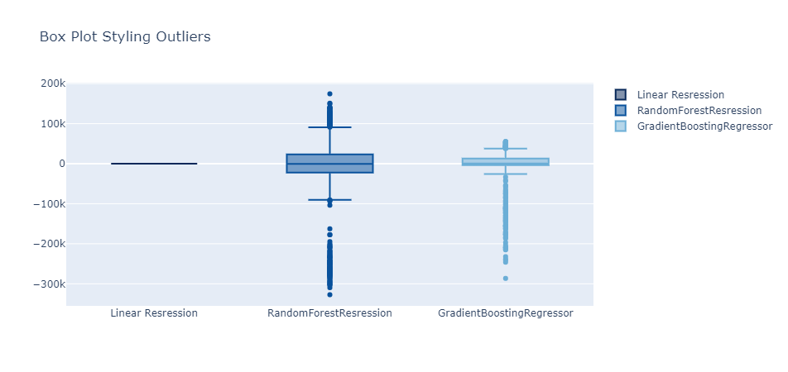
Error Analysis
Linear Regression：
Most accurate and efficient. Runtime much lower than other models.(over fitting)
Average MAE: almost zero
Gradient Boosting Regression:
Largest runtime. Error is unbiased.
Average MAE: 14852.22
Random Forest Regression:
Error is biased on several large cities.
Average MAE:27947.35

Slide 18
Summary
Region | Affordability |  | Migration Corr | Inventory Corr | Investor Corr | Rent (in USD) |  | House Value |  | Price to Rent Ratio |  | Unemployment Rate
Year | 2001 | 2021 | 2020 | 2022 | 2021 | 2014 | 2021 | 2014 | 2021 | 2014 | 2021 | 2014 | 2020
San Diego | 5.926 | 8.714 | 0.4 | -0.76 | 0.81 | 1766 | 2573 | 463657 | 766797 | 21.86 | 24.82 | 6.5 | 9.2
San Francisco | 8.433 | 10.4 | 0.78 | 0.37 | -0.71 | 2286 | 2943 | 7.72E+05 | 1.28E+06 | 28.15 | 36.35 | 4.4 | 7.8
Denver | 5.792 | 7.069 | 0.87 | -0.5 | 0.68 | 1246 | 1763 | 289546 | 537979 | 19.36 | 25.42 | 4.8 | 8.2
Boston | 7.183 | 6.716 | 0.67 | 0.6 | -0.048 | 2135 | 2556 | 384092 | 578037 | 14.98 | 18.84 | 5.3 | 9.7
Wichita |  |  | -0.81 |  |  | 744 | 871 | 117358 | 169097 | 14.32 | 16.17 | 2.8 | 2.1
Los Angeles | 6.466 | 10.565 | 0.45 | -0.68 | -0.33 | 1866 | 2574 | 516797 | 806990 | 23.07 | 26.11 | 8.2 | 12.8
Ventura | 5.456 | 8.106 | 0.17 | -0.76 | -0.31 | 1932 | 2745 | 507485 | 744693 | 21.88 | 22.6 | 6.7 | 8.6
St. Louis | 2.449 | 3.044 | -0.77 | -0.86 | 0.95 | 909 | 1146 | 146287 | 212048 | 13.4 | 15.4 | 5.2 | 7.2
New York | 6.169 | 6.15 | 0.6 | 0.86 |  | 2287 | 2560 | 400368 | 545016 | 14.58 | 17.73 | 6 | 9.5

